Slide 1
Math Methods

Slide 2
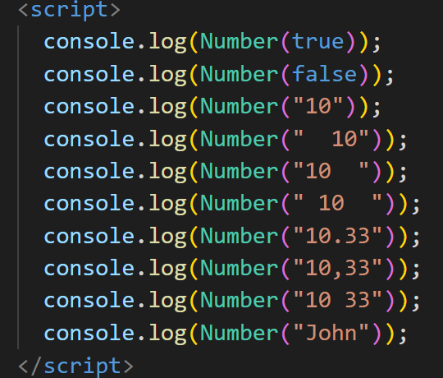
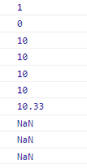
Number

Slide 3
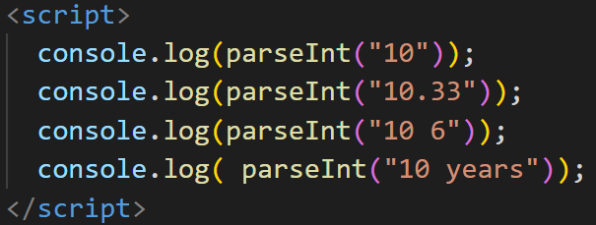

parseInt

Slide 4
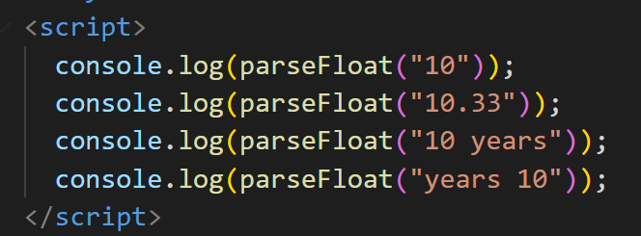

parseFloat

Slide 5

Math.PI

Slide 6


Math.round

Slide 7


Math.Sqrt

Slide 8


Math.pow

Slide 9


Math.abs

Slide 10


Math.ceil

Slide 11


Math.Floor

Slide 12


Math.max

Slide 13


Math.min

Slide 14
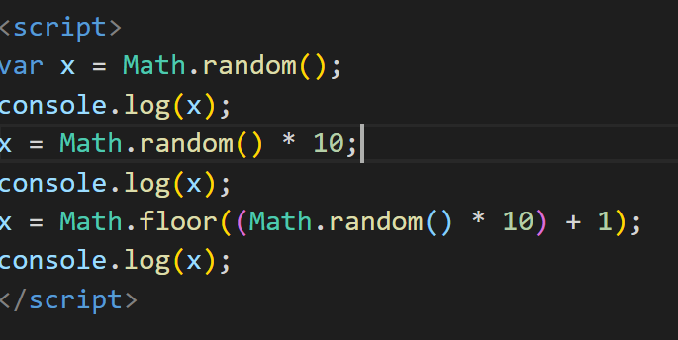

Math.random

Slide 15
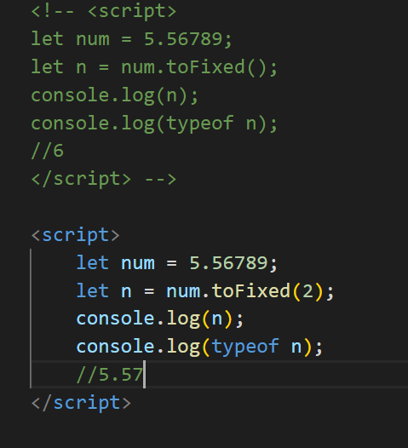
toFixed

